Slide 1
Computer Graphics Textures
László Szécsi szecsi@iit.bme.hu
AIT

Slide 2
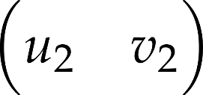
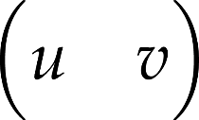
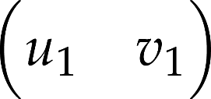
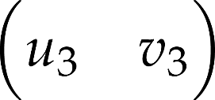



Texture mapping in OpenGL
color
texture coordinates from vertex buffer
Notes:
If texture mapping is enabled with glEnable(GL_TEXTURE_2D) texture coordinates are interpolated during rasterization, and the pixel color will be the color fetched from the texture image using the interpolated texture coordinates as an address. The color interpolated from the colors of the vertices is either ignored in replacing texture environment mode, glTexEnvi(GL_TEXTURE_ENV, GL_TEXTURE_ENV_MODE, GL_REPLACE),
or multiplied with the texture color in modulating texture environment mode, glTexEnvi(GL_TEXTURE_ENV, GL_TEXTURE_ENV_MODE, GL_MODULATE).
OpenGL may simultaneously store many textures, so we should select which texture to be applied or which texture is to be modified by glBindTexture(GL_TEXTURE_2D, id), where id is the integer identifier of the texture.

Slide 3
Texture object creation
this.glTexture = gl.createTexture();
this.image = new Image();
//after image has loaded
gl.bindTexture(gl.TEXTURE_2D, this.glTexture);
gl.texImage2D(gl.TEXTURE_2D, 0,
gl.RGBA, gl.RGBA,
gl.UNSIGNED_BYTE, this.image);

Slide 4
Texturing fragment shader
in vec2 texCoord;
uniform sampler2D colorTexture;
void main(void) {
fragmentColor = texture(colorTexture, texCoord);
}

Slide 5
Binding the texture to the sampler uniform
const samplerLocation =
gl.getUniformLocation(
glTexturingProgram, 'colorTexture');
gl.uniform1i(samplerLocation, 0);
gl.activeTexture(gl.TEXTURE0);
gl.bindTexture(gl.TEXTURE_2D, glTexture);

Slide 6
Texture filtering
texel > pixel (magnification)
texel values are samples of a continuous function
nearest
use the texel in which the pixel center is
bilinear
interpolate between nearest four
smears texel edges

Slide 7
Texture filtering
texel < pixel (far away surface)
a lot of texels fall in one pixel, value should be averaged
should be take the texel at the pixel centre, we would essentially pick on random
random pick changes with camera movement
solution
precompute averages: mipmaps

Slide 8
Texture filtering
texture space
screen space
Notes:
Rasterization visits pixels inside the projection of the triangle and maps the center of the pixel from screen space to texture space to look up the texture color. This mapping will result in a point that is in between the texel centers. More importantly, this mapping may be a minification (a texel is scaled to be smaller than a pixel), which means that a single step in screen space results in a larger step in texture space, so we may skip texels, and the result will be a mess or noise.
From signal processing point of view, in this case, the texture is a high frequency signal which is sampled too rarely, resulting in sampling artifacts.

Slide 9
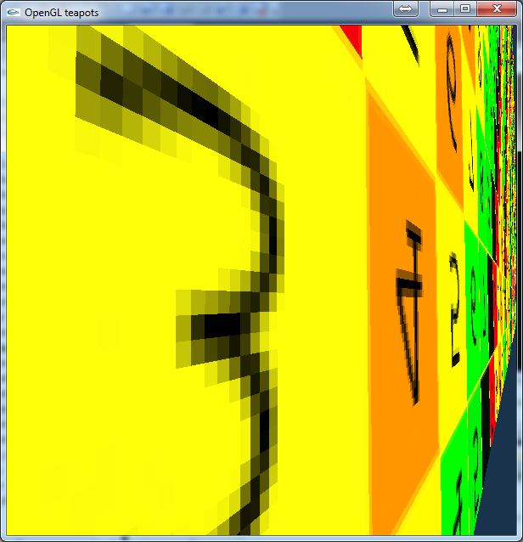
Magnification without filtering
Notes:
We may always use the color of the texel in which the pixel center is mapped. However, if we zoom in on the surface, texels will cover large groups of pixels. The pixels in one texel will have uniform color, and if the neighboring texel has just slightly different color, the boundary between them will be very much visible.

Slide 10
Bi-linear texture filtering
glTexParameteri(GL_TEXTURE_2D,
GL_TEXTURE_MIN_FILTER, GL_NEAREST);
glTexParameteri(GL_TEXTURE_2D,
GL_TEXTURE_MAG_FILTER, GL_LINEAR);
Notes:
To avoid the “pixilated” look, we can smooth the color by interpolating between the four neighboring pixel colors. As we interpolate linearly along both axes, this is referred to a bi-linear interpolation.

Slide 11
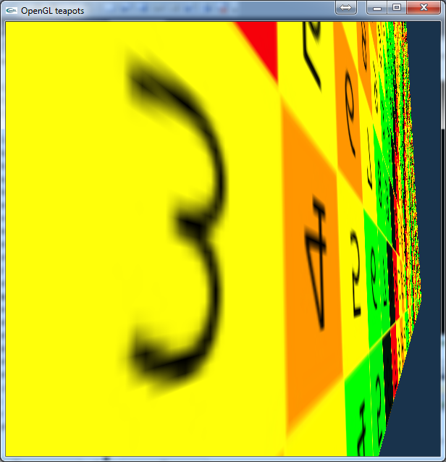
Magnification with binilear filtering
Notes:
This is a bit better, if not perfect. But what is going in back there, far away?

Slide 12
Minification
Notes:
That is some pretty random mess there. Even worse, if we move the camera a bit, we get a completely different random pattern. This is because a lot of texels are mapped to a single pixel, and we essentially choose between them on random, according to which texel the pixel center is mapped to. What we should be doing instead is to average all the texel colors in the pixel.

Slide 13
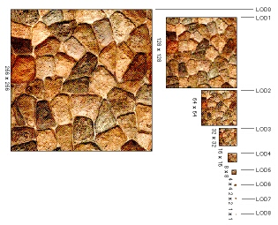
Mip-map (multum in parvo)
Y
X
Notes:
The solution for such sampling problems is filtering. Instead of mapping just the center of the pixel, the complete pixel rectangle must be mapped to texture space at least approximately, and the average of texels in this region should be returned as a color. However, it would be too time consuming.
One efficient approximation is to prepare the texture not only in its original resolution, but also in half resolution, quarter resolution, etc. where a texel represents the average color of a square of the original texel. During rasterization, OpenGL estimates the magnification factor, and looks up the appropriate version of filtered, downsampled texture. The collection of the original and downsampled textures is called mip-map.

Slide 14
What to work with?
any working 2D code will do
with Materials
preferrably GameObjects, too
even your homework-in-the-making
we will do nothing destructive
but always keep several backups of everything ;)

Slide 15
New attributes
we will introduce new attributes
texCoord for texturing
normal for 3D shading, used later
but remove the color attribute
we will never have to change attributes again
this means a new variant of Program.js and relevant geometries
TexturedProgram.js
TexturedQuadGeometry.js
later: TexturedIndexedTrianglesGeometry.js for 3D mesh

Slide 16
TexturedProgram.js
.
// make a copy of Program.js, rename to TexturedProgram.js
// change class name, too
gl.bindAttribLocation(this.glProgram, 0, "vertexPosition");
// replace color attribute with these two
gl.bindAttribLocation(this.glProgram, 1, "vertexNormal");
gl.bindAttribLocation(this.glProgram, 2, "vertexTexCoord");

Slide 17
TexturedQuadGeometry.js
make a copy of QuadGeometry.js
rename to TexturedQuadGeometry.js
rename class to TexturedQuadGeometry
change attributes as in following slides
grey code remains unchanged

Slide 18
TexturedQuadGeometry position
.
same
class TexturedQuadGeometry {
constructor(gl){
this.gl = gl;
this.vertexBuffer = gl.createBuffer();
gl.bindBuffer(gl.ARRAY_BUFFER, this.vertexBuffer);
gl.bufferData(gl.ARRAY_BUFFER,
new Float32Array([
-1, -1, 0.5,
-1, 1, 0.5,
1, -1, 0.5,
1, 1, 0.5,
]),
gl.STATIC_DRAW);

Slide 19
TexturedQuadGeometry normal
.
this.vertexNormalBuffer = gl.createBuffer();
gl.bindBuffer(gl.ARRAY_BUFFER, this.vertexNormalBuffer);
gl.bufferData(gl.ARRAY_BUFFER,
new Float32Array([
0, 0, 1,
0, 0, 1,
0, 0, 1,
0, 0, 1,
]),
gl.STATIC_DRAW);
we do not care about normals much now
(we add them in anticipation of 3D gfx)
but for a quad they point along z
very similar to the vertexColor attribute, just different name
this replaces vertexColor, as we will not have much need of that any more

Slide 20
TexturedQuadGeometry texture coords
.
new attribute buffer, with 2 floats per vertex
this.vertexTexCoordBuffer = gl.createBuffer();
gl.bindBuffer(gl.ARRAY_BUFFER, this.vertexTexCoordBuffer);
gl.bufferData(gl.ARRAY_BUFFER,
new Float32Array([
0, 1,
0, 0,
1, 1,
1, 0,
]),
gl.STATIC_DRAW);
texture corners mapped to quad's corners

Slide 21
TexturedQuadGeometry index buffer
.
same
this.indexBuffer = gl.createBuffer();
gl.bindBuffer(gl.ELEMENT_ARRAY_BUFFER, this.indexBuffer);
gl.bufferData(gl.ELEMENT_ARRAY_BUFFER,
new Uint16Array([
0, 1, 2,
1, 2, 3,
]),
gl.STATIC_DRAW);
};
two triangles

Slide 22
TexturedQuadGeometry input layout (a.k.a. VAO) - positions
.
no change at all
this.inputLayout = gl.createVertexArray();
gl.bindVertexArray(this.inputLayout);
gl.bindBuffer(gl.ARRAY_BUFFER, this.vertexBuffer);
gl.enableVertexAttribArray(0);
gl.vertexAttribPointer(0,
3, gl.FLOAT, //< three pieces of float
false, //< do not normalize (make unit length)
0, //< tightly packed
0 //< data starts at array start
);

Slide 23
TexturedQuadGeometry input layout (a.k.a. VAO) - normals
.
vertexColor renamed
gl.bindBuffer(gl.ARRAY_BUFFER, this.vertexNormalBuffer);
gl.enableVertexAttribArray(1);
gl.vertexAttribPointer(1,
3, gl.FLOAT, //< three pieces of float
false, //< do not normalize (make unit length)
0, //< tightly packed
0 //< data starts at array start
);
new name, same format

Slide 24
TexturedQuadGeometry input layout (a.k.a. VAO) - texCoords
.
new attribute, 2 floats per vertex
gl.bindBuffer(gl.ARRAY_BUFFER, this.vertexTexCoordBuffer);
gl.enableVertexAttribArray(2);
gl.vertexAttribPointer(2,
2, gl.FLOAT, //< two pieces of float
false, //< do not normalize (make unit length)
0, //< tightly packed
0 //< data starts at array start
);
gl.bindVertexArray(null);
}

Slide 25
TexturedQuadGeometry draw
.
draw = function() {
const gl = this.gl;
gl.bindVertexArray(this.inputLayout);
gl.bindBuffer(gl.ELEMENT_ARRAY_BUFFER, this.indexBuffer);
gl.drawElements(gl.TRIANGLES, 6, gl.UNSIGNED_SHORT, 0);
}
}
same
number of indices

Slide 26
Texturing fragment shader textured-fs.glsl
.
Shader.source[document.currentScript.src.split('js/shaders/')[1]] = `#version 300 es
precision highp float;
out vec4 fragmentColor;
in vec2 texCoord; // pass this on from vertex shader
// we need to bind texture to this
uniform struct{
sampler2D colorTexture;
} material;
void main(void) {
fragmentColor = texture(material.colorTexture, texCoord);
}
`;
You probably want to keep your old fragment shader for untextured objects, so it is a good idea to create a new file.

Slide 27
Task: vertex shader
.
write this on your own
again, it makes sense to create a new file
keeping the old one for untextured/color-attribute-using stuff
it is the same as before, but
instead of color = vertexColor
forwards input vertexTexCoord to output texCoord, thus providing the fragment shader with input
note that the type is not vec3

Slide 28
We need to
create WebGL texture
load HTML image
upload image to texture
plus generate mipmap levels
set texture filtering
set uniform
bind texture
Texture2D.js
WebGLMath/Sampler2D.js

Slide 29
Texture2D.js object constructor
.
add to pending list (no drawing until list is empty)
"use strict";
/* exported Texture2D */
class Texture2D {
constructor(gl, mediaFileUrl){
gl.pendingResources[mediaFileUrl] =
++gl.pendingResources[mediaFileUrl] || 1;
this.mediaFileUrl = mediaFileUrl;
this.glTexture = gl.createTexture();
this.image = new Image();
this.image.onload = () => { this.loaded(gl); };
this.image.src = mediaFileUrl;
}
create WebGL texture resource
create HTML image element (as if on webpage)
trigger loading image
call method loaded when ready

Slide 30
Texture2D.js loaded
.
select this Texture object's WebGL texture as current
loaded(gl){
gl.bindTexture(gl.TEXTURE_2D, this.glTexture);
gl.texImage2D(gl.TEXTURE_2D, 0,
gl.RGBA, gl.RGBA, gl.UNSIGNED_BYTE, this.image);
gl.texParameteri(gl.TEXTURE_2D, gl.TEXTURE_MAG_FILTER,
gl.LINEAR);
gl.texParameteri(gl.TEXTURE_2D, gl.TEXTURE_MIN_FILTER,
gl.LINEAR_MIPMAP_LINEAR);
gl.generateMipmap(gl.TEXTURE_2D);
gl.bindTexture(gl.TEXTURE_2D, null);
if( --gl.pendingResources[this.mediaFileUrl] === 0 ) {
delete gl.pendingResources[this.mediaFileUrl];
}
}
}
upload image to GPU to mipmap level 0
data format
set bilinear filtering for magnification
set trilinear filtering (mipmapping)
compute mipmap levels >0
remove from pending resources

Slide 31
Tasks: add resources and scene elements
.
create new Shader objects from new VS and FS sources
create new TexturedProgram object with the above
create a new Material with the above program
set the colorTexture property of the material
use the set method, pass a new Texture2D
download asteroid.png, place it in a folder ‘media’
create an instance of TexturedQuadGeometry
create Mesh, GameObject using the above
Notes:
WebGLMath/Sampler2D has a set method that takes WebGL texture IDs, or anything with a property glTexture
Texture2D objects have the property glTexture, so they can be passed on

Slide 32
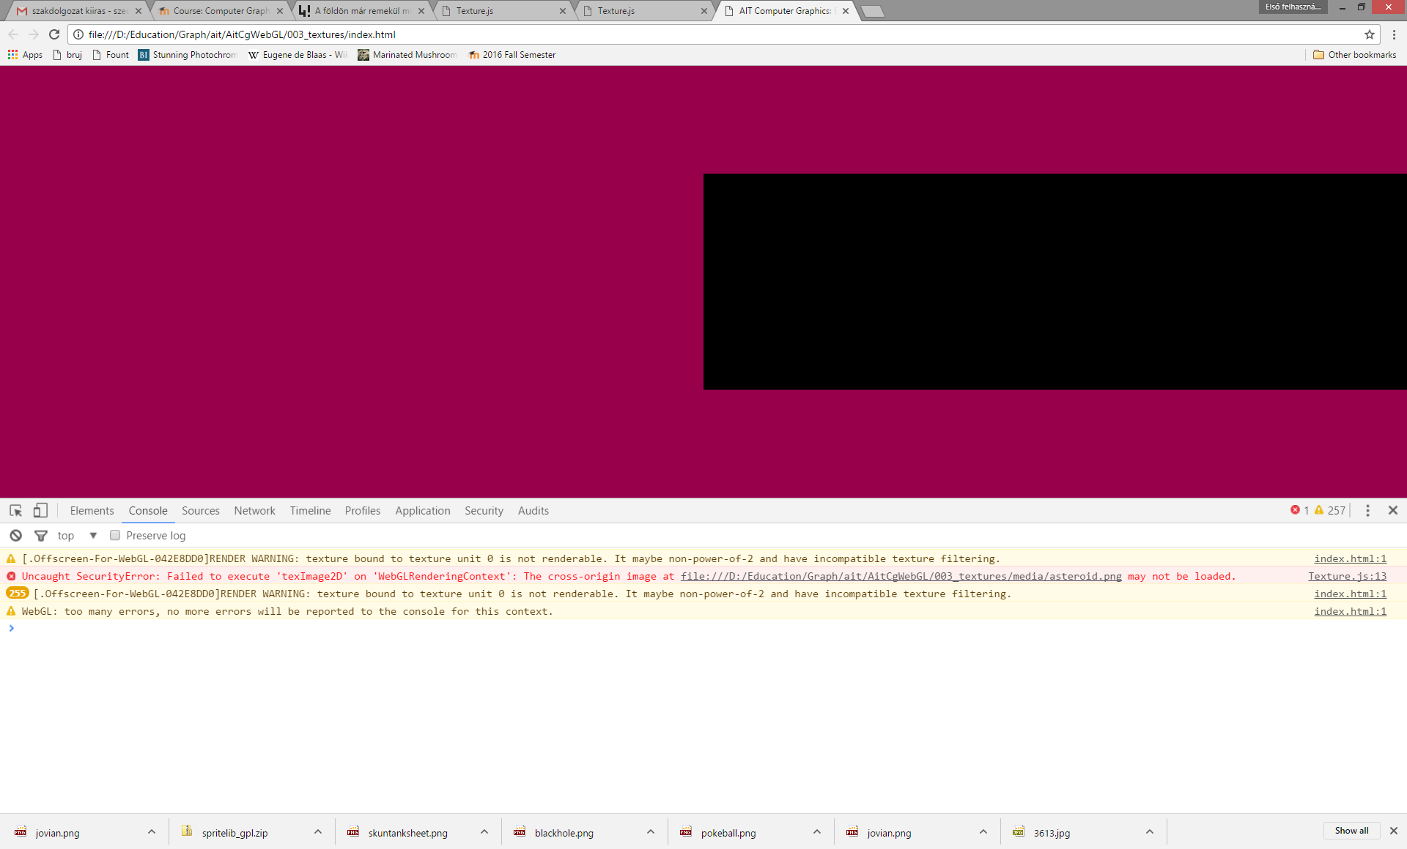
Does not work ☹
.

Slide 33
Solutions
.
create a web server or upload project to web server
tedious
not really good for debugging
allow file access
must start Chrome with command line switch
--allow-file-access-from-files
it is a good idea to create a shortcut in Windows
or type this on Mac OS X terminal
open /Applications/Google\ Chrome.app --args --allow-file-access-from-files
close Chrome before doing this!

Slide 34
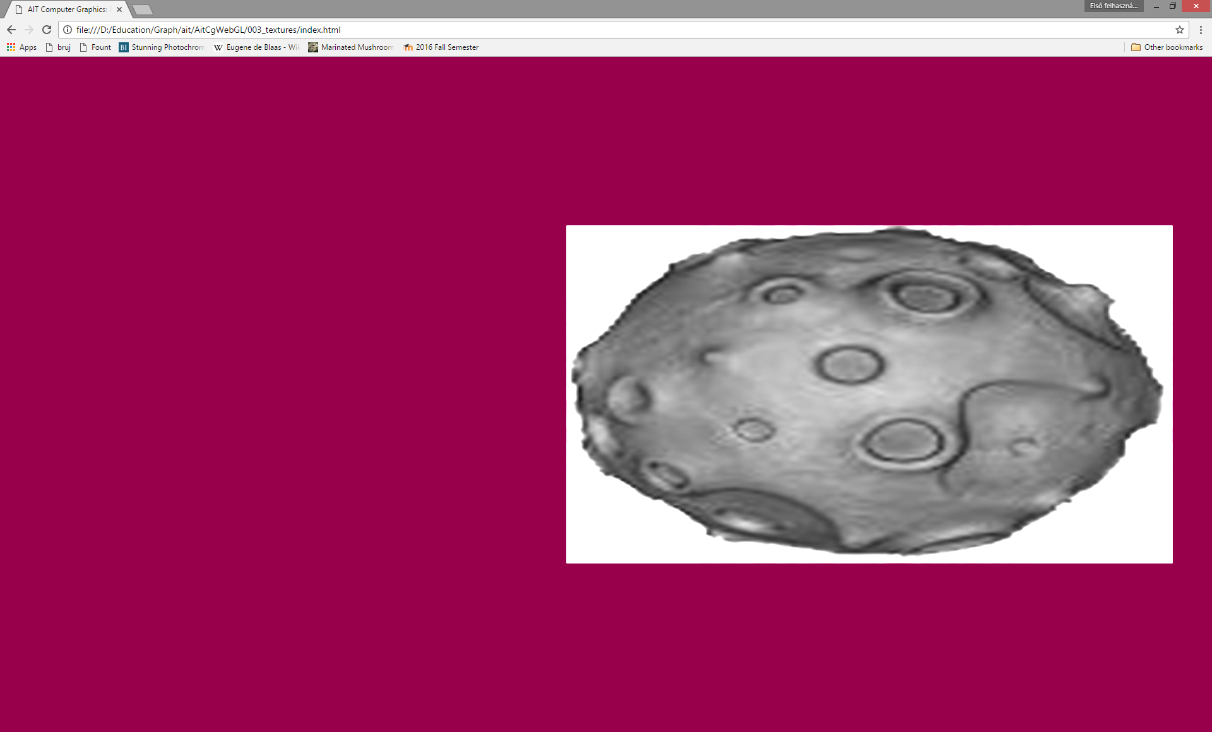
Textured billboard
!

Slide 35
Enable alpha blending
!
gl.enable(gl.BLEND);
gl.blendFunc(
gl.SRC_ALPHA,
gl.ONE_MINUS_SRC_ALPHA);

Slide 36
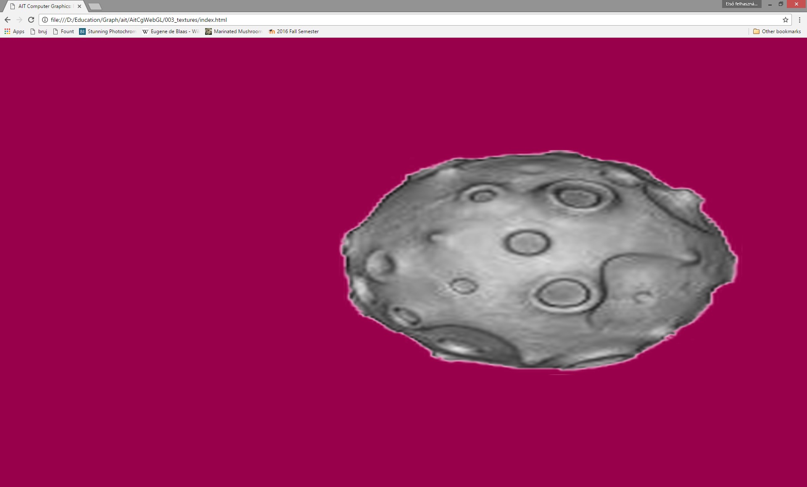
With alpha blending
!

Slide 37
Experiment with filtering
!
loaded(gl){
gl.bindTexture(gl.TEXTURE_2D, this.glTexture);
gl.texImage2D(gl.TEXTURE_2D, 0,
gl.RGBA, gl.RGBA, gl.UNSIGNED_BYTE, this.image);
gl.texParameteri(gl.TEXTURE_2D, gl.TEXTURE_MAG_FILTER,
gl.NEAREST/*gl.LINEAR*/);
gl.texParameteri(gl.TEXTURE_2D, gl.TEXTURE_MIN_FILTER,
gl.LINEAR /*gl.LINEAR_MIPMAP_LINEAR*/);
gl.generateMipmap(gl.TEXTURE_2D);
gl.bindTexture(gl.TEXTURE_2D, null);
if( --gl.pendingResources[this.mediaFileUrl] === 0 ) {
delete gl.pendingResources[this.mediaFileUrl];
}
}
}
try making the object really large, and set magnification filter to nearest
try making the object really small and rotating, and disable mipmapping

Slide 38
Experiment with texture coords (wrapping)
!
this.vertexTexCoordBuffer = gl.createBuffer();
gl.bindBuffer(gl.ARRAY_BUFFER, this.vertexTexCoordBuffer);
gl.bufferData(gl.ARRAY_BUFFER,
new Float32Array([
0, 1,
0, 0,
1, 1,
1, 0,
]),
gl.STATIC_DRAW);
what happens if you multiply these with 2?
what happens if you multiply these with 0.5?
what about negatives?

Slide 39
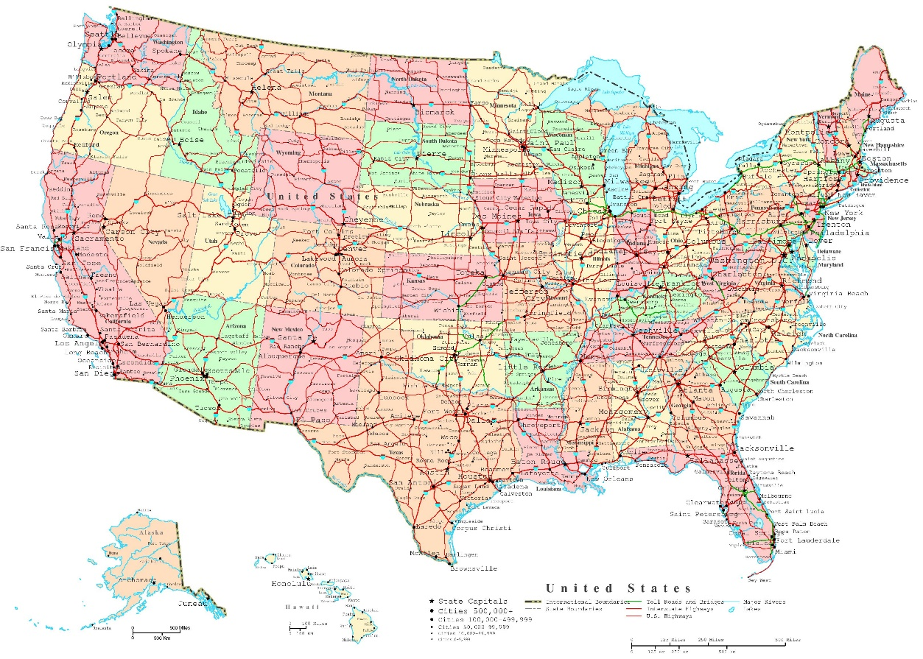
Where do you come from?
!
use usa.jpg
set texture coordinates so that the state where you are from is shown on the quad

Slide 40
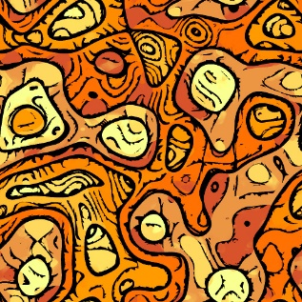
Seamless tiling
!
use pattern.jpg
set textures so that the image is repeated many times over the quad

Slide 41
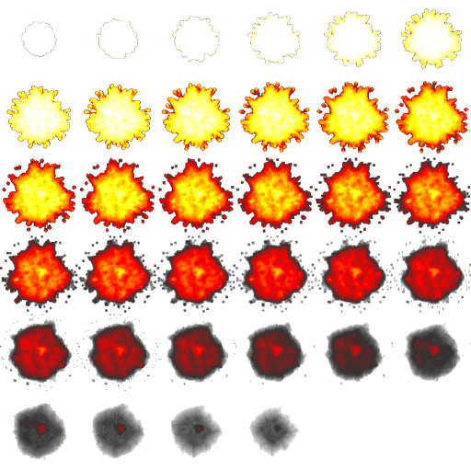
Sprite animation
!
use boom.png
scale texture coordinates in vertex shader to show just one phase
add some number to show a different phase
pass a time-dependent value as a uniform parameter to identify current phase
it is better to do calculations on the JS side, and pass an offset that you just have to add to the texture coordinates before scaling them in the VS

